Slide 1
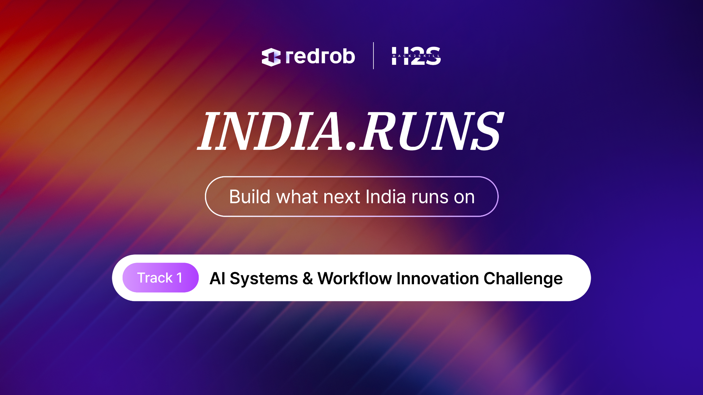

Slide 2

Redrob Context & Ideathon Scope
Redrob AI is building an AI-native ecosystem spanning hiring, productivity, communication, discovery, workflows, recommendations, automation, and intelligent user experiences.
Participants are encouraged to think beyond standalone applications and explore how their ideas can:
Extend existing Redrob capabilities
Improve experiences for Redrob users
Introduce new AI-native workflows
Strengthen ecosystem engagement and network effects

Slide 3

Important
Participants are not expected to build a completely new platform from scratch.
Strong submissions will demonstrate:
How the idea leverages existing Redrob capabilities
What new capability, workflow, or value layer is introduced
How the idea strengthens the overall Redrob ecosystem
Why Redrob is uniquely positioned to enable this experience

Slide 4
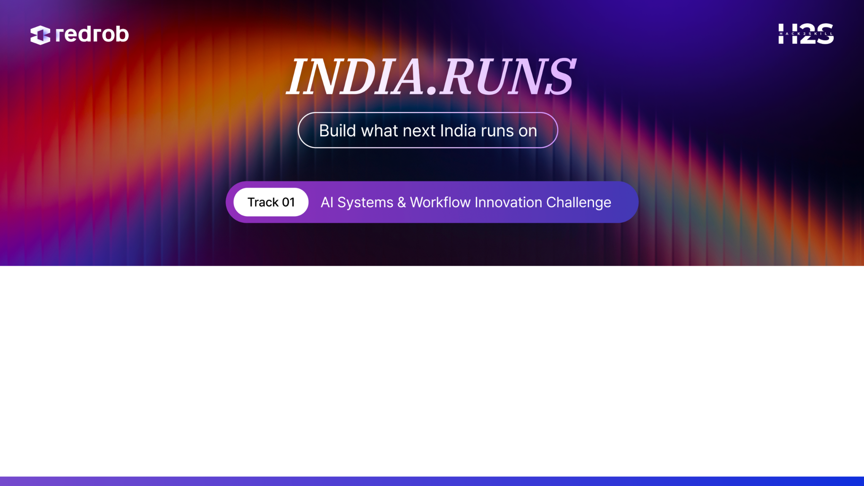
Team Name :
Problem Statement :
Team Members :

Slide 5
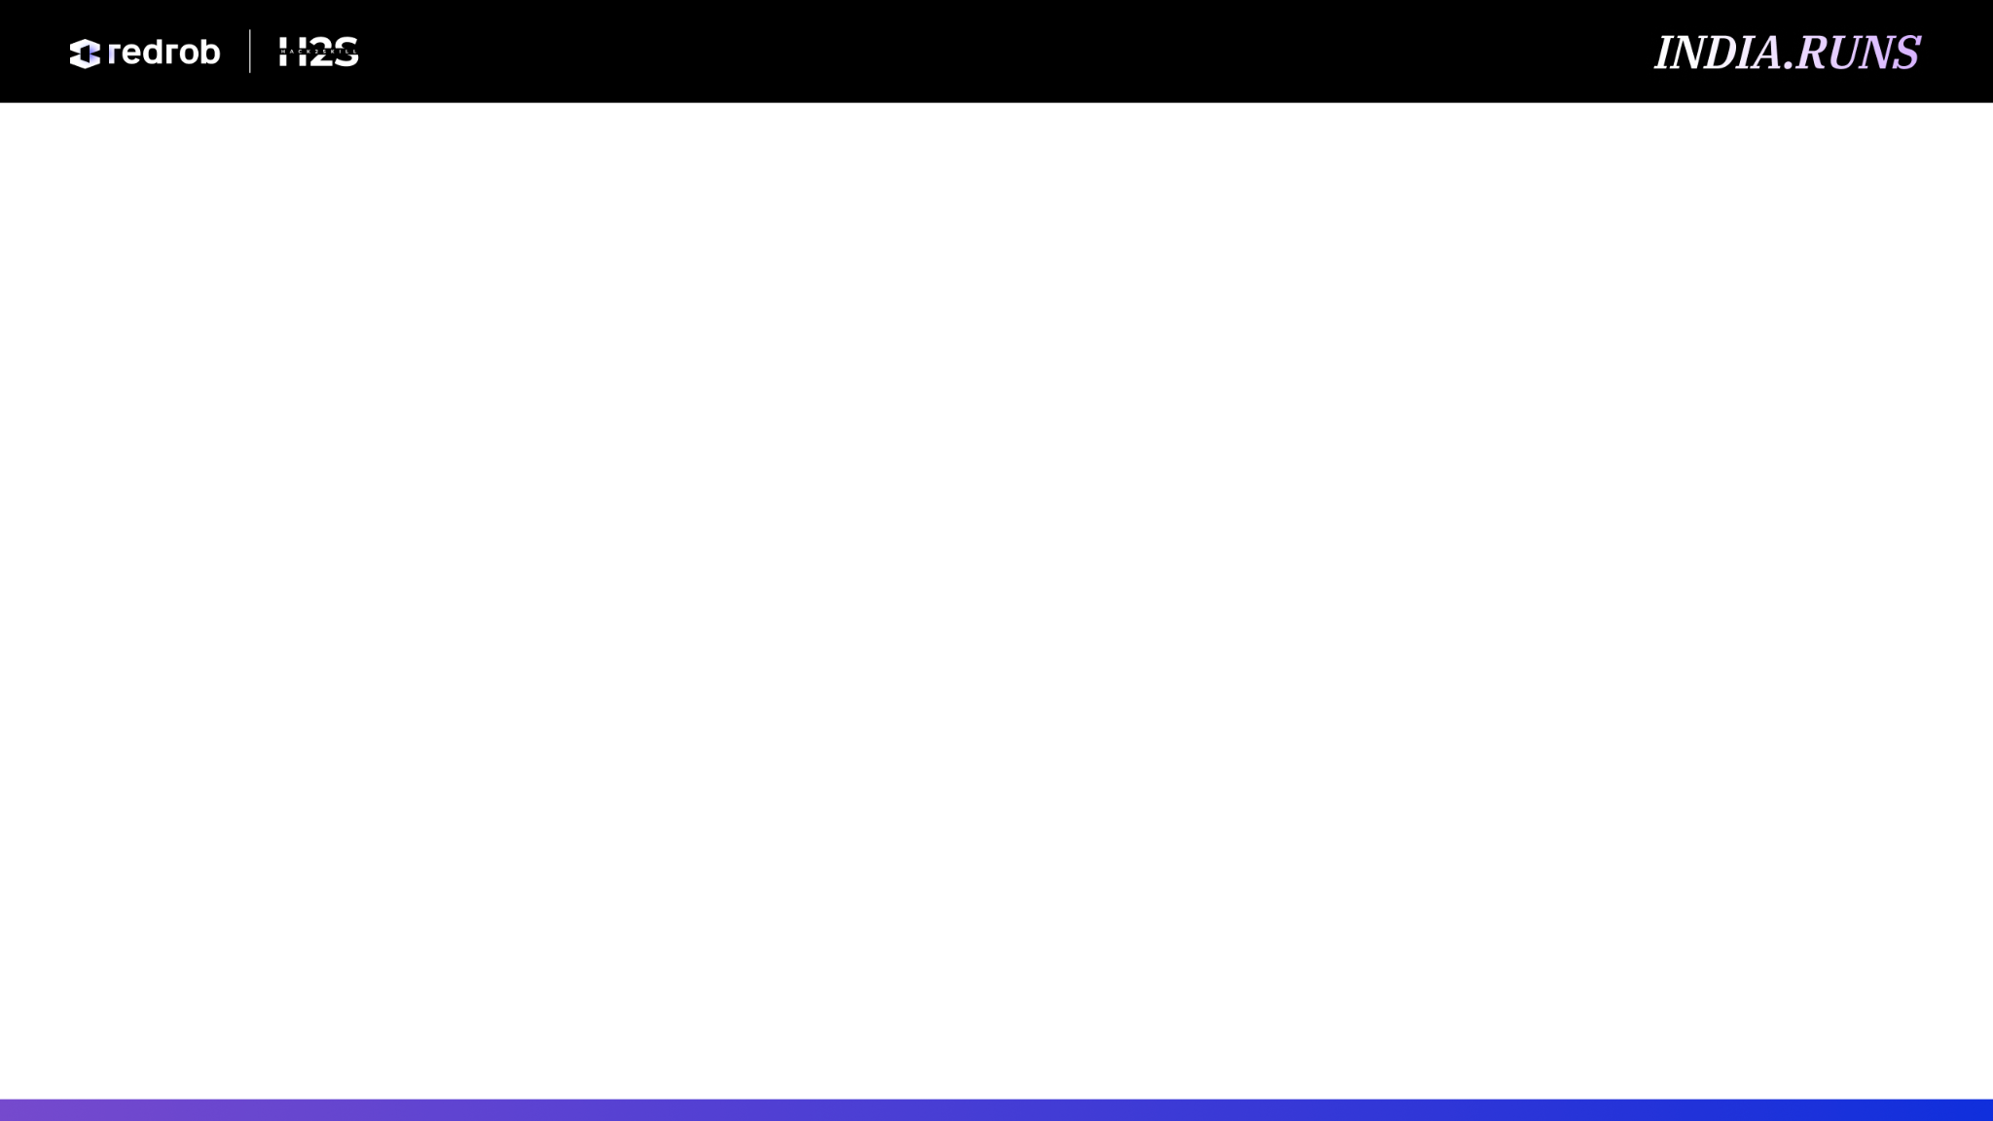
Problem Definition
Questions
What problem are you solving?
Who experiences this problem?
Why is the current approach insufficient?

Slide 6
Opportunity & Vision
Questions
Why is this an important opportunity?
What future state are you enabling?

Slide 7
Solution Overview
Questions
What is your proposed solution?
What makes it AI-native rather than AI-assisted?
Which existing Redrob capability, workflow, or user journey does your solution build upon?

Slide 8
User Journey / Workflow Diagram
Questions
How does a user interact with the solution?
How does information flow through the process?
Where does the solution integrate with Redrob experiences?
Mandatory Visual
Workflow Diagram

Slide 9
AI Logic & Decision Flow
Questions
Where does AI intervene?
How are decisions made?
How do agents/models/reasoning systems interact?
Mandatory Visual
AI Flow Diagram

Slide 10
System Architecture
Questions
What components make up the system?
How do services interact?
Which Redrob systems, workflows, or services are leveraged?
Mandatory Visual
Architecture Diagram

Slide 11
Data, Context & Intelligence Layer
Questions
What data powers the solution?
How is context retrieved, stored, or utilized?
How does existing Redrob context, signals, or workflows improve the experience?
Mandatory Visual
Data Flow Diagram

Slide 12
Scalability & Technical Feasibility
Questions
How would this be implemented?
How does the system scale?
What technical challenges exist?

Slide 13
Redrob Ecosystem Integration
Questions
Which existing Redrob capabilities are being leveraged?
What new capability does your solution introduce?
How does it strengthen the overall Redrob ecosystem?
What additional opportunities become possible after implementation?
Mandatory Visual
Ecosystem Integration Diagram

Slide 14
Impact & Success Metrics
Questions
What measurable outcomes are expected?
How will success be tracked?
What value is created for users and Redrob?

Slide 15
Future Roadmap
Questions
How could this evolve over 2–3 years?
What future capabilities can be unlocked?
What broader vision does this support?

Slide 16
